Slide 1
Programming Language Concepts

Slide 2
The question

Slide 3
What is PL about?
Not developing knowledge of particular languages
You can’t do PL absent any language, but…
The languages of the moment change (more and more rapidly)
We want to focus on the underlying concepts, not the surface details

Slide 4
What is PL about?
Not developing knowledge of particular languages
Not implementing languages
Implementation cannot dictate design
Can realize PL design without knowing most of what drives practical language implementation

Slide 5
A program
Here is a program:
def something(n):
a, b = 0, 1
for i in range(n):
a, b = b, a + b
return b
What does it do?
Does it do so correctly?

Slide 6
Another program
Here is a program:
def something(n):
a, b = 0, 1
for i in range(n):
a, b = b, a + b
return a
Does this fix the bug in the previous program?
How would you convince me?

Slide 7
Program correctness
So how can we know if a program is correct?
Testing. But how do we know if we’ve done enough cases?
Intuition. But how do you know that your intuition of the meaning of a Python program corresponds to what CPython will do?
Social processes. But even lots of programmers can be wrong.
Can we give a definitive account of what a (particular) program means?

Slide 8
Programming Languages
The goal of the study of programming languages is give definitive accounts of what programs mean:
What do they do? (I.e., what inputs lead to what outputs)
How do they do it? (I.e., what happens along the way)
Analogy: engineering disciplines are built on physics and calculus. PL is the physics of software development. Logic is our calculus.

Slide 9
The science of computing

Slide 10
The long view
1965 | UI computer science department established
1962 | First (US) department of computer science, Purdue
1959 | General use of the term “computer science” Louis Fine. "The Role of the University in Computers, Data Processing, and Related Fields"
1949 | First stored-program computer (EDVAC) John von Neumann, First Draft of a Report on the EDVAC
1945 | First general-purpose computer (ENIAC) John Mauchly and J. Presper Eckert
1928 | Founding question of computer science Hilbert & Ackerman’s Grundzüge der theoretischen Logik

Slide 11
The foundations of mathematics
Historically: intuition of the physical world
Geometry: science (that is, knowledge) of space
Analysis: science of measure

Slide 12
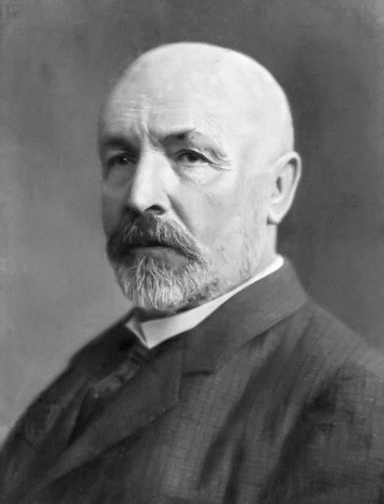
The foundations of mathematics
Historically: intuition of the physical world
The foundational crisis
Non-Euclidian geometries
The meaning of infinity
Georg Cantor (1845–1918)
German mathematician
“On a Property of the Collection of All Real Algebraic Numbers”: proves that the real numbers are uncountably infinite

Slide 13
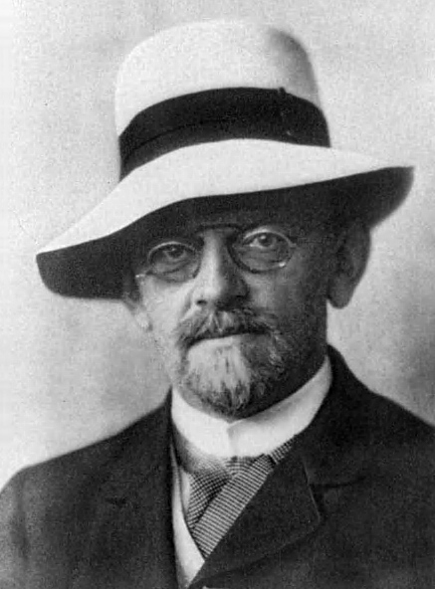
The founding question
David Hilbert (1862–1943)
German mathematician
Logicist: believed that the foundations of mathematics could be found in logic (“Hilbert’s program”)
Entscheidungsproblem (1928)
German for “decision problem”
Algorithm to determine whether a logical statement is universally valid
Proved impossible in 1936, 1937.

Slide 14
Founding a science of computing
Hilbert asked for an algorithm
I.e., a procedure, a recipe, a sequential sequence of rules
Not a novel idea (Babbage, Lovelace, Jacquard looms, &c.)
“Just” need to show that a particular set of rules is well-defined and correct
Church and Turing showed that no such algorithm exists
Need to characterize all possible algorithms
Show that none of them solve the Entscheidungsproblem
In each case: show that a simpler instance of the Entscheidungsproblem is unsolvable

Slide 15
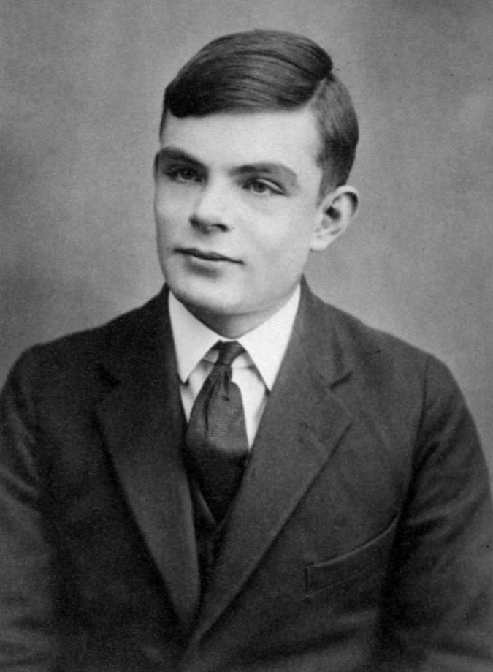
Computation, mechanically
Alan Turing (1912–1954)
English mathematician, cryptographer
Important contributions across computer science, artificial intelligence, defeating Nazis
“On Computable Numbers, with an Application to the Entscheidungsproblem.” (1936)
Turing machines: automata that perform computational processes
Halting undecidable: no TM exists that, given the code for another TM, can determine whether that TM halts

Slide 16
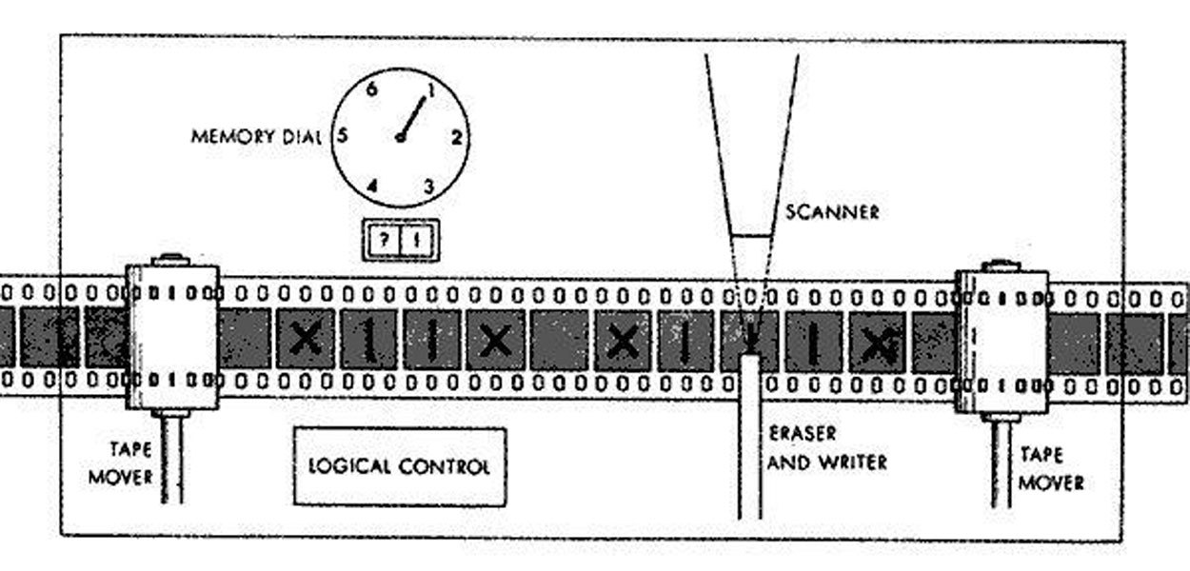
Turing’s machines
A Turing machine has three components:
The tape, a (changeable) list of symbols
The state, (a representation of) the current state of the machine
The update function, from state and tape to new state and new tape
1 2 4 | 2 4
1 2 5 | 2 3
1 2 6 | 2 2
…
1 4 8 | 0 0

Slide 17

Turing’s machines
Universality:
Can express Turing machines themselves as inputs to other Turing machines: $⌊M⌋$ is code for machine $M$
Universal Turing Machine: $U\left(\left\lfloor M\right\rfloor ,x\right)=M\left(x\right)$.
The halting problem:
Turing showed you couldn’t have a machine $H\left(\left\lfloor M\right\rfloor ,x\right)$ that determined whether $M\left(x\right)$ halts

Slide 18
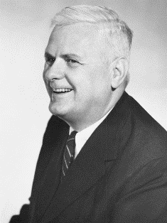

Computation, linguistically
Alonzo Church (1903–1955)
American mathematician, logician, philosopher
Important contributions to foundations of mathematics, meaning of language
“An unsolvable problem of elementary number theory” (1935)
$λ$-calculus: language of functions and function applications
Equivalence undecidable: No $λ$-calculus term that determines whether two other $λ$-calculus terms are equivalent

Slide 19




The $λ$-calculus
The $λ$-calculus has two operations:
Abstraction: defines functions
Application: uses them
Richer data encoded in functions. E.g., numbers:
$$0 ≔f x↦x \\ 1 ≔f x↦f\left(x\right) \\ 2 ≔f x↦f\left(f\left(x\right)\right) \\ …$$
$$n+m ≔f x↦n(f, m(f, x)$$

Slide 20

The $λ$-calculus
Encoding functions
Church showed that arbitrary $λ$-calculus terms can be encoded as numbers …
and that those codes can be interpreted as the original terms.
Approach originally due to Gödel, but using a more complex language
Term equivalence
Church showed that you couldn’t have a function $E$ such that $E\left(F,G\right)$ return true if $F$ and $G$ were identical functions, false otherwise.

Slide 21

The science of computation
Turing machines and the $λ$-calculus express exactly the same set of functions!
Two branches of theoretical computer science
Turing machines focus on mechanism of computation ⇒ computational complexity, automata theory
$λ$-calculus focuses on language of computation ⇒ logic, programming languages

Slide 22
Programming languages

Slide 23

Connecting the dots
You might wonder: What’s the $λ$-calculus got to do with Python?
We need to build up to understanding complex languages and complex language features
We need a language in which to describe languages

Slide 24

Complex languages
Let’s think about a bit of Python code again:
def fun(…):
…
x = f()
y = g()
h(x, y)
…
Suppose we start executing f(). What statement will we execute next?
Suppose f() returns $V$. Is $V$ the same in h?
Suppose g() returns $W$. Is $W$ the same in h?

Slide 25
Complex languages
Why do we think Python is simple?
It has good libraries
It’s consistent with our intuition
But neither of these are properties of the language!
If we started by trying to understand Python, we’d never get off the ground.

Slide 26

Simple languages
What makes the $λ$-calculus simple?
Few syntactic forms
Originally: just abstraction and application
We’ll make things a little easier by adding a handful more
Few semantic rules
Program execution is predictable
Meaning of programs is local

Slide 27
Building complexity
We still need to account for complex languages.
Model complex language features using simple ones
Explain programs that use complex features by programs that don’t.
Abstracting language features
Models of language features themselves have common structure
Languages can describe, abstract over their own features

Slide 28
Doing PL
What do we actually do?
Define the structure of a language, called its syntax
Not interested in details, like comments, line endings
Generally described in terms of trees.

Slide 29
Doing PL
What do we actually do?
Define the structure of a language, called its syntax
Define the meaning of the language, called its semantics
Reducing programs to their “simplest” forms
Mapping from new languages to older languages (like math)

Slide 30
Doing PL
What do we actually do?
Define the structure of a language, called its syntax
Define the meaning of the language, called its semantics
Describe the expressiveness of languages
By example
Or by relating programs in different languages

Slide 31
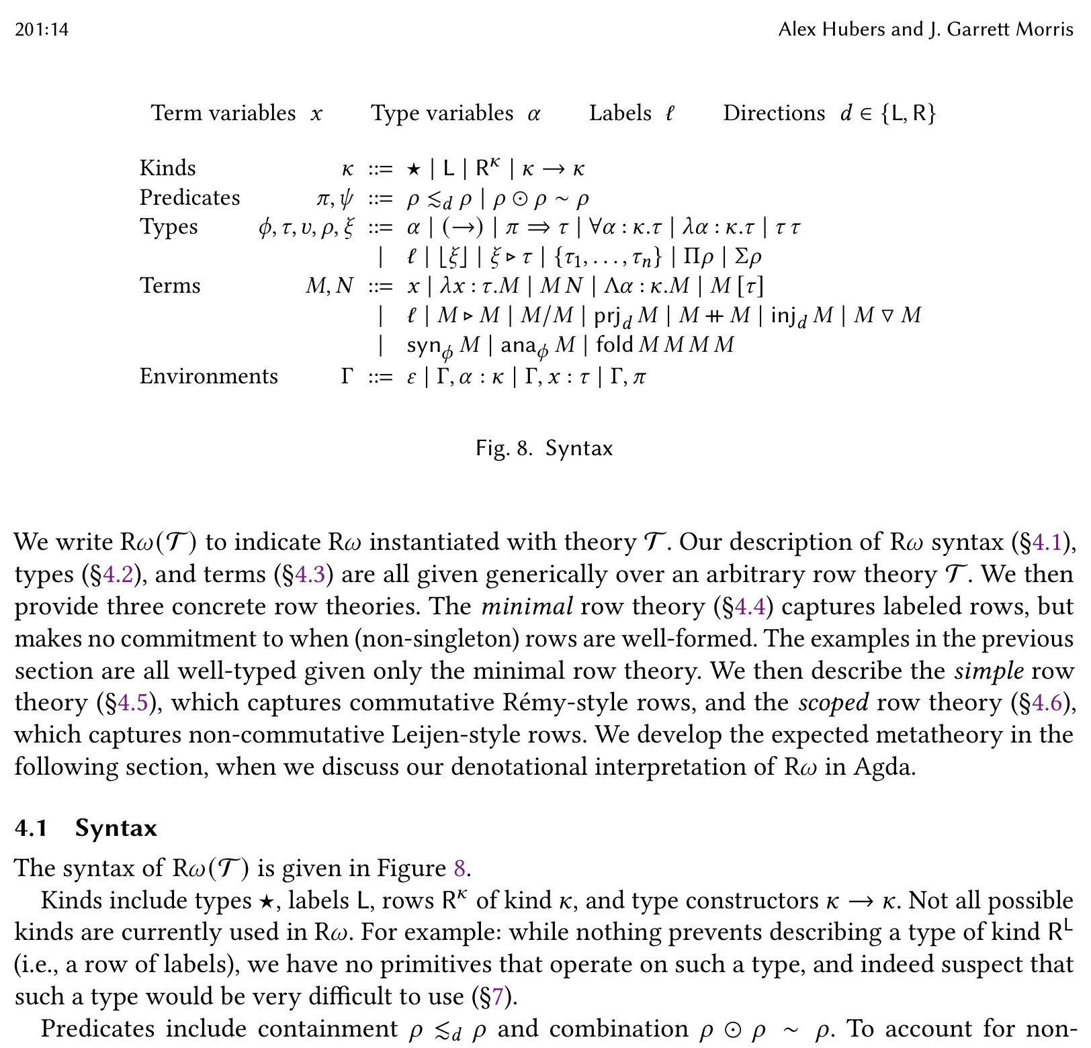
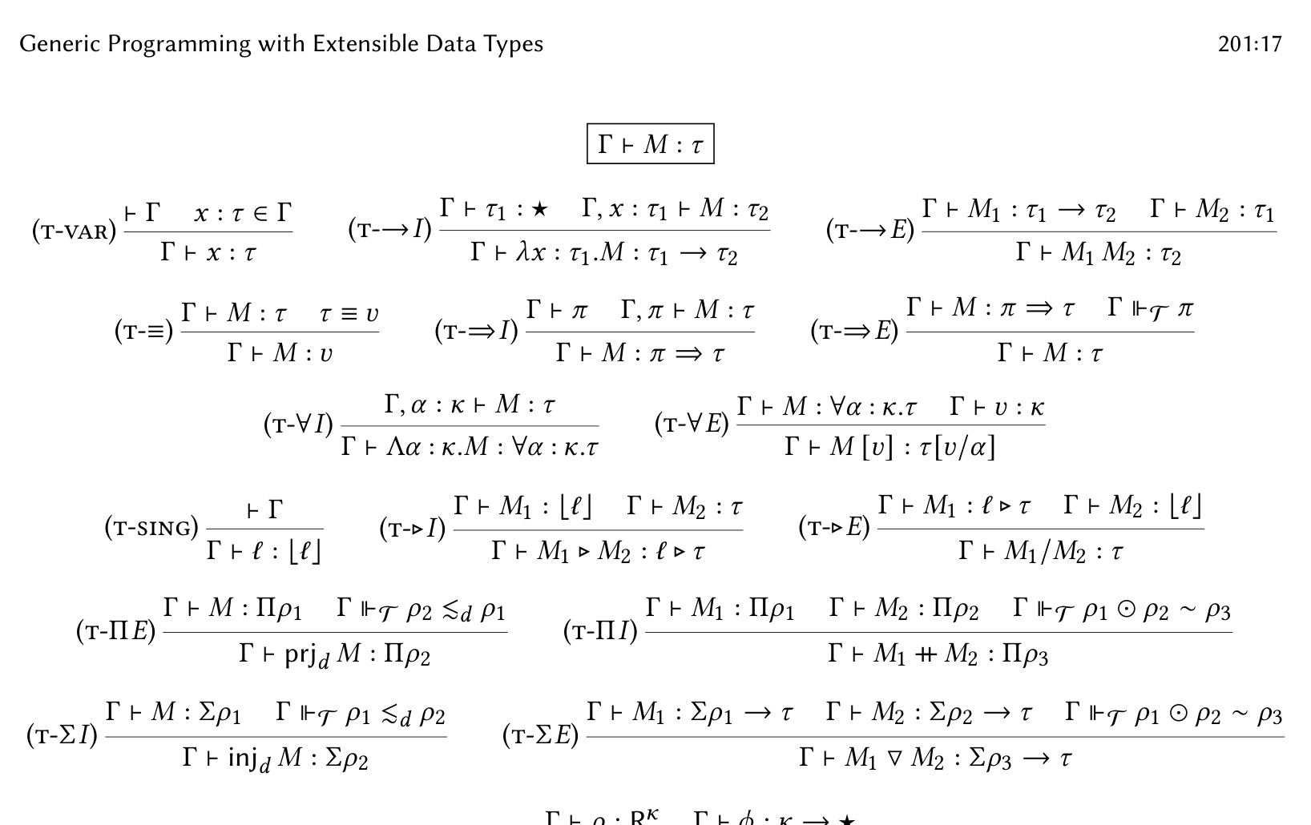
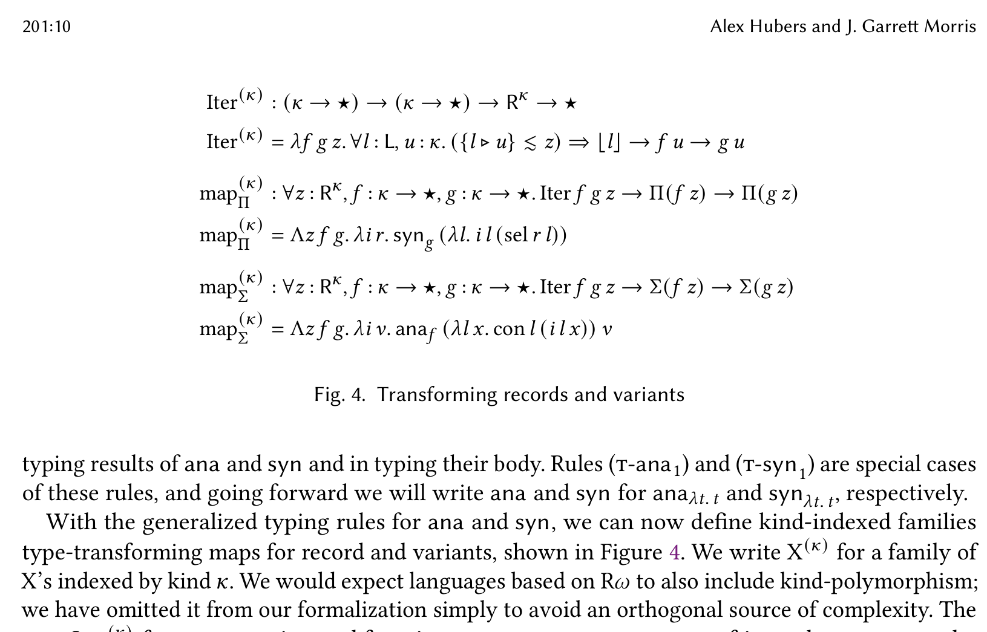
Doing PL
What do we actually do?
Define the structure of a language, called its syntax
Define the meaning of the language, called its semantics
Describe the expressiveness of languages
We can do these with pen and paper.

Slide 32
Doing PL
What do we actually do?
Define the structure of a language, called its syntax
Define the meaning of the language, called its semantics
Describe the expressiveness of languages
Or, we could do it with programs!
Formally: writing proofs (in interactive theorem provers)
Informally: writing interpreters (in ordinary programming languages)

Slide 33

This course
Part 1: Practical functional programming
Introduces the Haskell language and tools, and tries to reframe your thinking about what a program is.
Part 2: Simple types and the $λ$-calculus
Describes a simple, general programming language and its semantics
Part 3: Effects and types
Builds complex language features out of simple ones, in both Haskell and the $λ$-calculus.
Part 4: Advanced topics
Surveys some interesting things currently happening in PL development.

Slide 34
The point of CS education
“The half-life of engineering knowledge—the time in which half of what an engineer knows becomes obsolete—varies by field, but is estimated to be in the range of 2.5 to 7.5 years. … But we must question the value of narrow specialization at a time when engineered systems are becoming larger, more complex, …”
– William A. Wulf, President of the National Academy of Engineering

Slide 35
How to succeed in this course

Slide 36
Lecture
Many lectures will have both theoretical and practical content.
Practical: how to program in Haskell—both details (syntax, tools) and approach.
Theoretical: how to think about Haskell specifically, and language features generically.
“It may take a few times for Haskell to ‘click’ with you, so don't give up. … Personally my biggest problem with Haskell was how you have to take a lot of things at face value in the start.”
“Attempt to understand the lectures rather than just copying his code”

Slide 37
Office hours
This isn’t a correspondence course!
Office hours:
Morris: Mondays 11 AM – 1 PM, 1412 SC (to start)
Sabharwal: Wednesday 3:30 – 5:30 PM, 201C MLH
Asynchronous questions via Piazza or GitHub
“If any form of confusion arises, ask immediately, ask without hesitation, ask anything; Haskell without the ‘ask’ is self explanatory.”

Slide 38
Assessment
Weekly problem sets 70%
6.36% per week (lowest score dropped)
Reinforces and develops lecture content
“Make sure you do the problems of the week, it will help you understand Haskell syntax and it'll help you do the project a lot more effectively.”
“Take the problems at the beginning seriously because you use those principles in the project.”

Slide 39
Assessment
Weekly problem sets 70%
Midterm exams 20%
September 26 10%
October 26 10%
You must pass the exams to pass the course
“Pay attention to the theoretical part of the course, specifically the lambda calc. While it may not apply to the project, the way of thinking about those types of problems is going to directly apply to the project.”

Slide 40
Assessment
Problem of the week 70%
Midterm exams 20%
Project 10%
Significant development of language implementation
In pairs (assigned)
“Give yourself enough time to understand the program in the final project before starting to work on it.”
“Work iteratively on the project, separate it into chunks you can do week by week.”

Slide 41
Partial credit
There isn’t any.
“The chair of a department of a Big Ten university once observed, probably after a bad day, that it was possible for a student to graduate with a mathematics major without ever having solved a single problem correctly. Partial credit can go a long way.”
Assessment based on suites of test cases
Test cases will be available from the beginning of each problem
No surprises, no interpretation

Slide 42
Extra credit
There’s a survey on the ICON page.
If 80% of the class completes it by the start of class Thursday, the entire class gets 0.5% bonus to their semester grade.

Slide 43
Academic honesty
The work you submit should be yours/your groups, and yours/your groups alone.
Problem of the week: feel free to discuss problems and their solutions, but solution writeups should be individual. Please do not share problems or their solutions online.
Project: feel free to discuss specifications, but please do not discuss solutions.
Questions: please ask.
Faculty can’t say that academic honesty matters unless they act like academic honesty matters.

Slide 45
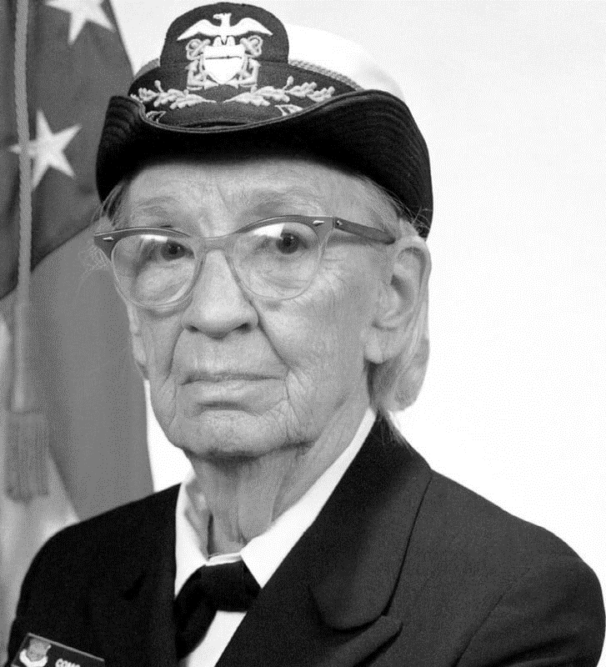
General purpose programming
RADM Grace Murray Hopper (1906–1992)
American mathematician and computer scientist
Designer of various programming languages
“The Education of a Computer” (1952)
Describes the first compiler/linker
“Programming in English”—widely rejected when first proposed

Slide 46
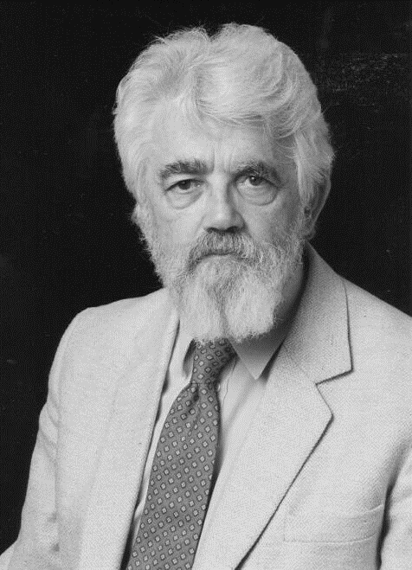

Programming with functions
John McCarthy (1927–2001)
American computer and cognitive scientist
Founder of artificial intelligence
“Recursive Functions of Symbolic Expressions and Their Computation by Machine” (1960)
Programming language based on the $λ$-calculus
Designed to facilitate AI experiments

Slide 47
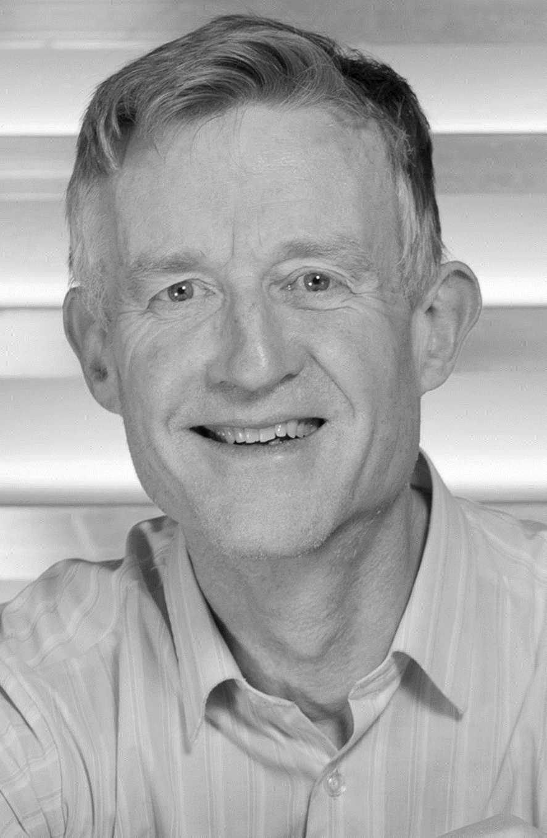
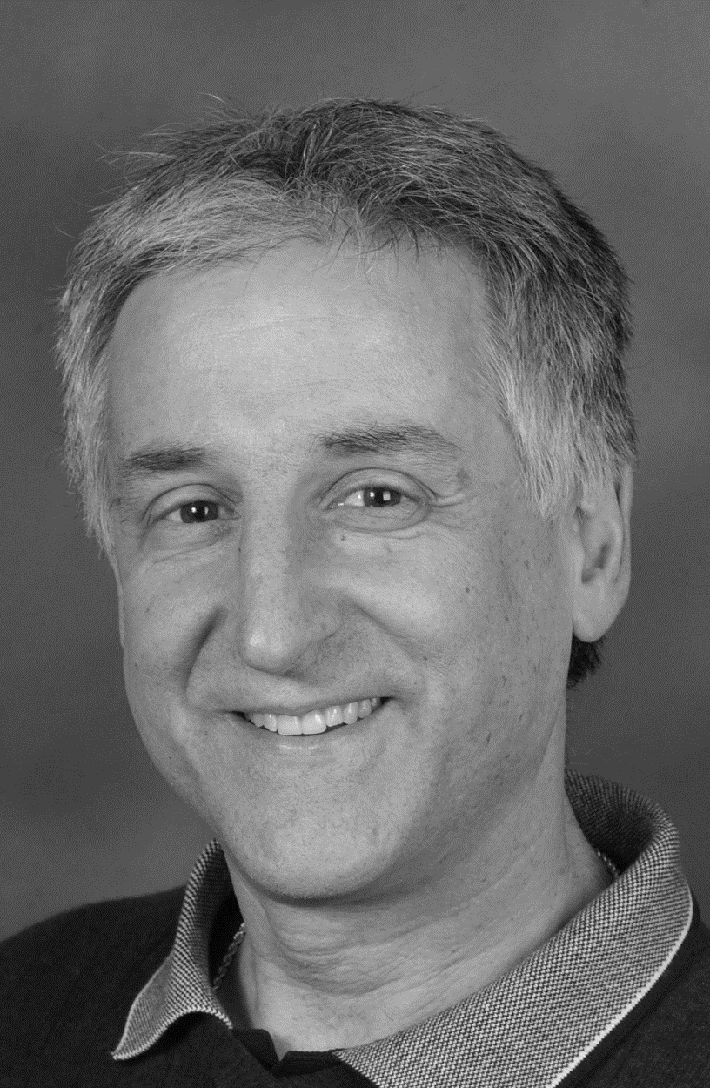
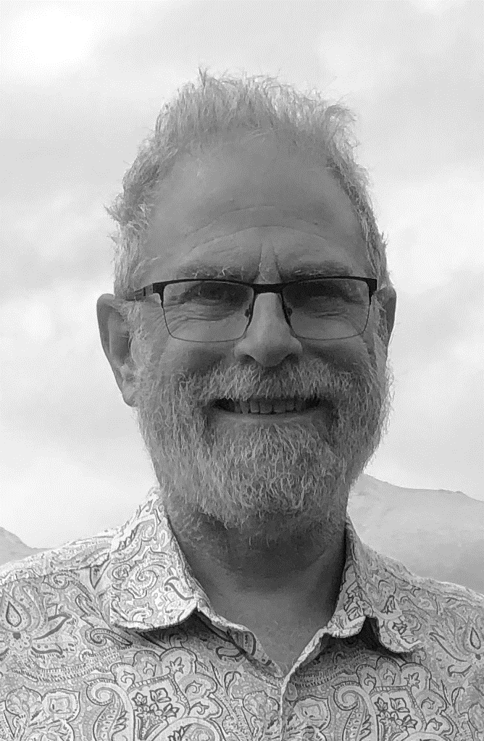
Programming purely with functions
Paul Hudak (1952–2015)
Simon Peyton Jones (1958–)
Philip Wadler (1956–)
“Report on the Programming Language Haskell: A Non-strict, Purely Functional Language” (1992)

Slide 48
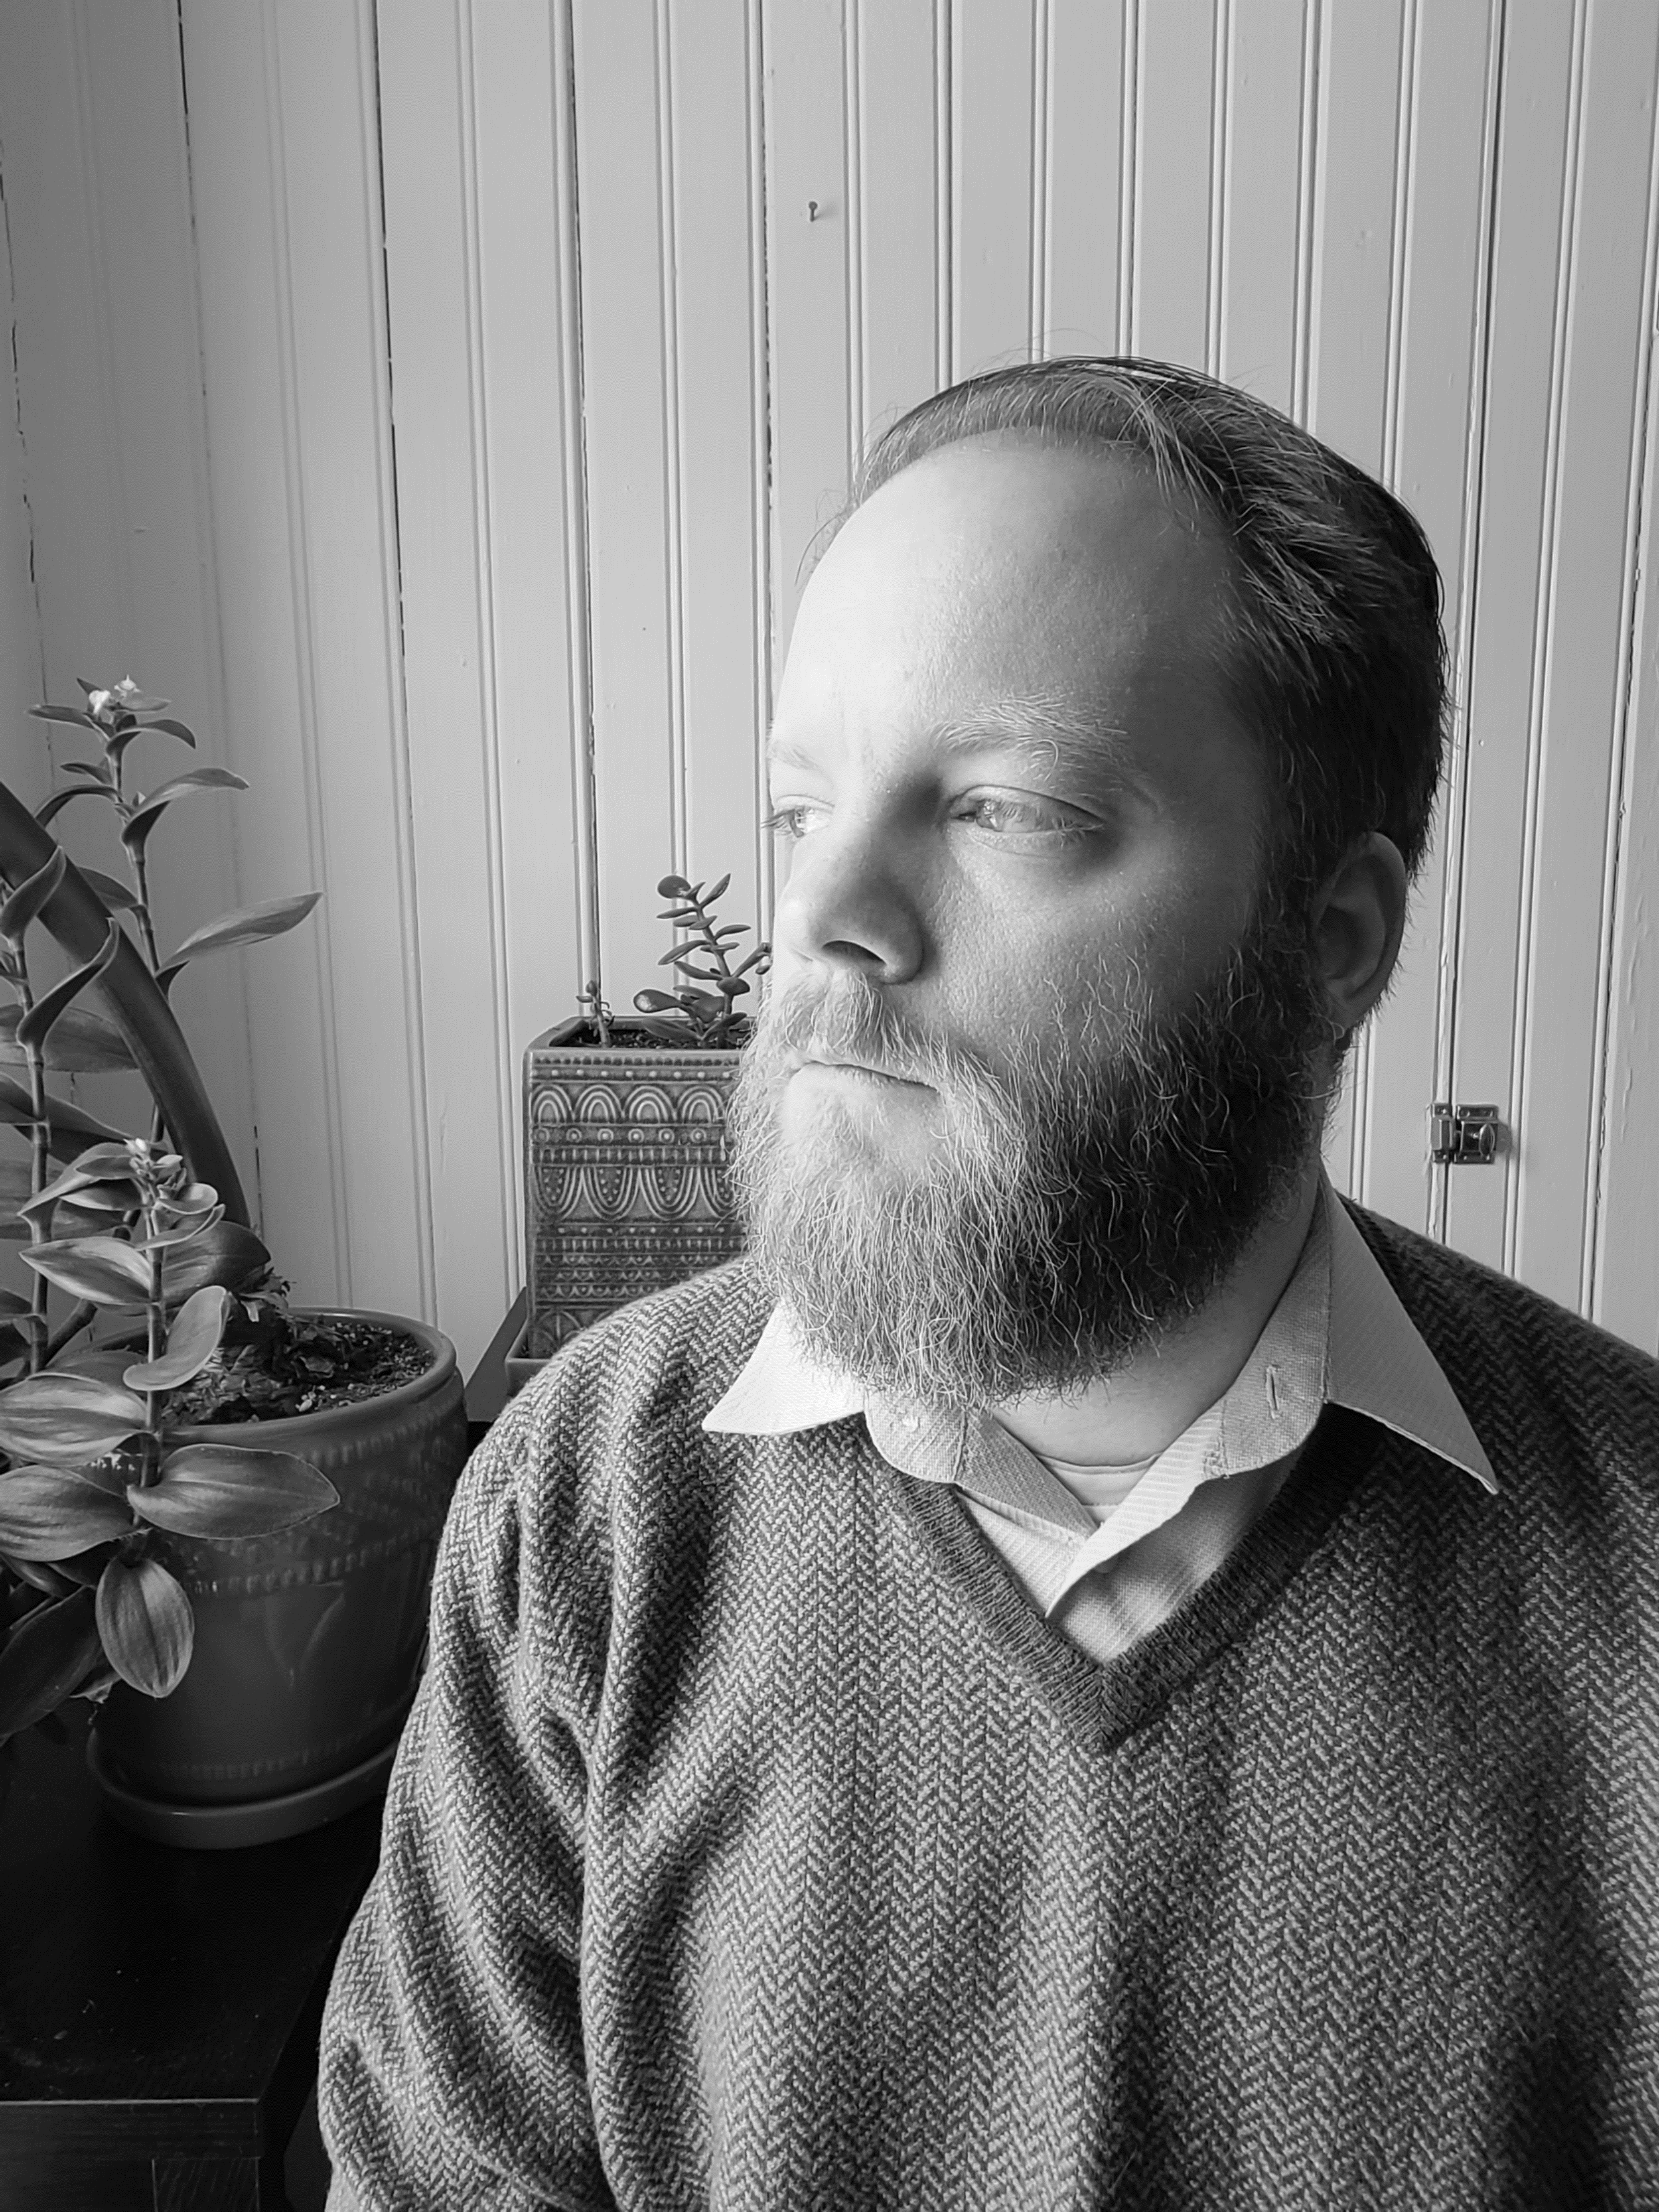
Basically irrelevant
J. Garrett Morris (1983–)
Haskeller since first year of college
Studies type systems and logic
Your instructor

Slide 49

Theory and practice
Church and Turing proposed theoretical models of computing
Can express every computable function
Theoretical models are small, so they’re easy to analyze
You wouldn’t want to build Turing Machines, or program in pure $λ$-calculus
Functional programming languages build on Church’s model

Slide 50
Learning PL with Haskell
Haskell sits at the intersection of PL theory and practice.
Language design and features inspired by theory in CS and mathematics
Practical applications (currently mainly in (distributed) finance and defense)
This makes Haskell ideal for learning PL theory.
PL theory explains Haskell programs (less direct for Python, C)
PL ideas realized as Haskell libraries and idioms

Slide 51
The aims of education in computing science

Slide 52
The goals of PL theory
What do programs mean?
Operationally vs denotationally: do we care about how programs compute, or just what they compute?
A priori or A posteriori: do we find structure in how programs are created, or discover the structure present in existing programs?
What can we do about it?
Compilation and optimization: how can we most efficiently realize the meaning of a program?
Type systems and verification: what can we (automatically or with programmer assistance) prove about programs?

Slide 53
Practicing computing science
We discover/explore computational idea through implementation.
Systems: implementing and testing system components
Theory: abstract descriptions of algorithms
In PL: we explore programs by programming.
Interpreters and compilers
Type checkers and static analyzers
Language tools and editors
This course: using interpreters (broadly understood) to express the meaning of language features.

